Slide 1
Advanced Dotnet
Parameswari

Slide 2
Goals
Generics
Delegates
Events
Lambda Expressions
LINQ Queries
Concurrency and Asynchrony
Parallel Programming

Slide 3
Generics
Generics are a programming construct that enables you to create classes, methods, delegates, and interfaces that work with various data types without specifying the actual type until the code is used.
This results in more flexible, type-safe, and reusable code.
The primary motivation for using generics is to write code that can handle different data types while maintaining compile-time type checking.
This prevents runtime errors and improves code quality by making it more robust and maintainable.

Slide 4
The Need for Generics
Suppose we are building an application that needs to store and manipulate data of different types (e.g., integers, strings, or custom objects).
Without generics, we might be forced to create separate collections and methods for each data type, resulting in code redundancy and decreased maintainability.
With generics, you can create a single collection or method that can work with any data type, allowing for more efficient and concise code.

Slide 5
Generics
Generics are classes, structures, interfaces, and methods that have placeholders (type parameters) for one or more of the types that they store or use.
A generic collection class might use a type parameter as a placeholder for the type of objects that it stores.
The type parameters appear as the types of its fields and the parameter types of its methods.
A generic method might use its type parameter as the type of its return value or as the type of one of its formal parameters.

Slide 6
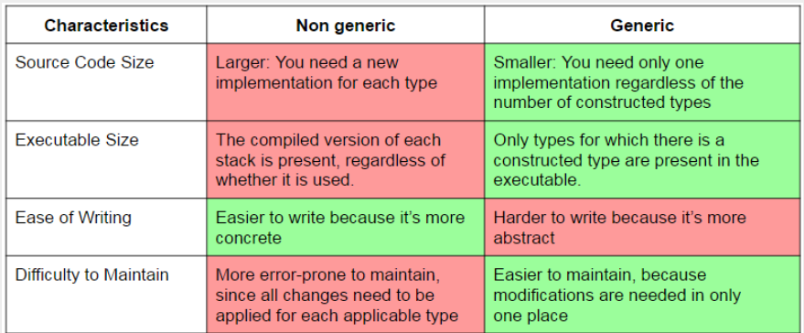
Non-Generic vs Generic

Slide 7
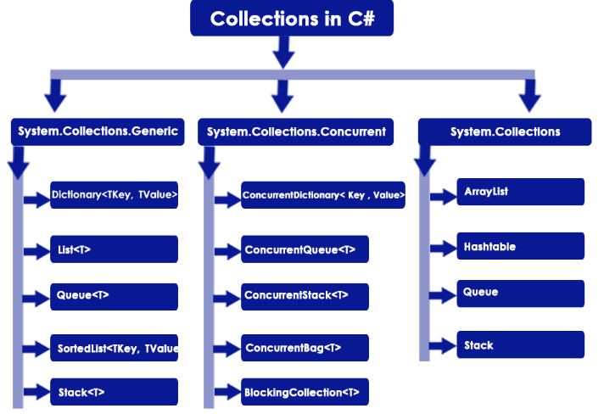
Collections and Generics in c#

Slide 8
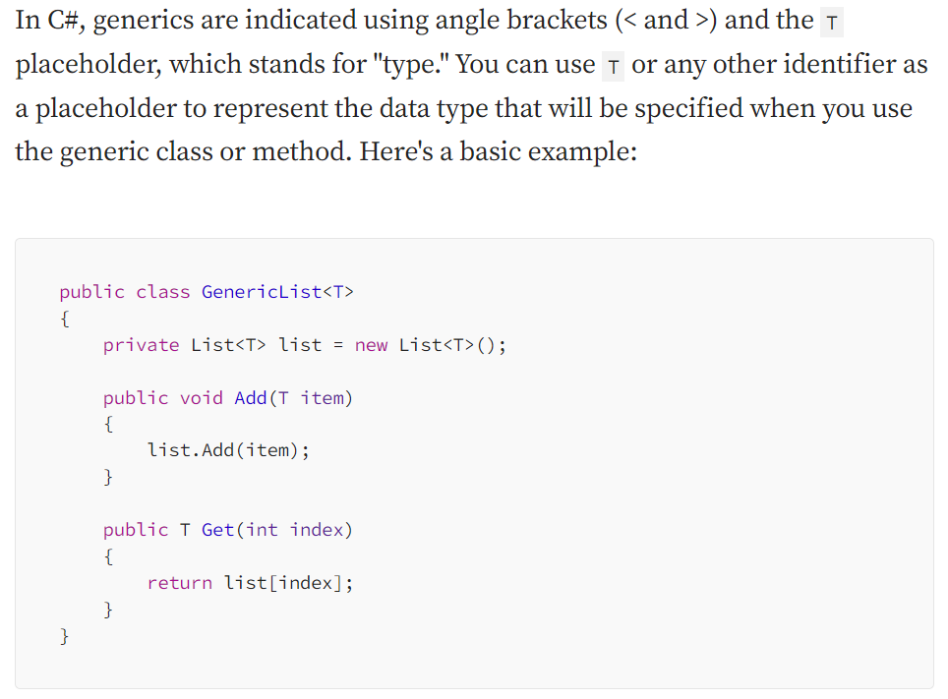
Basics of Generics

Slide 9
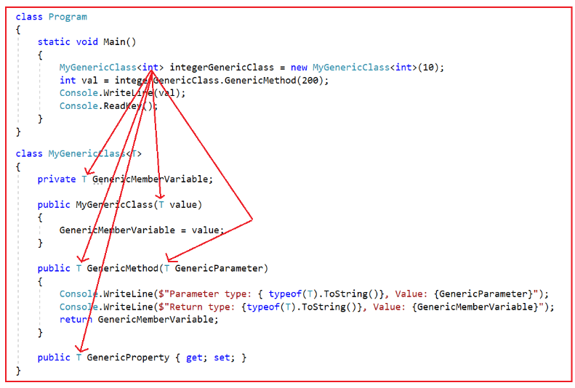
Basics of Generics

Slide 10
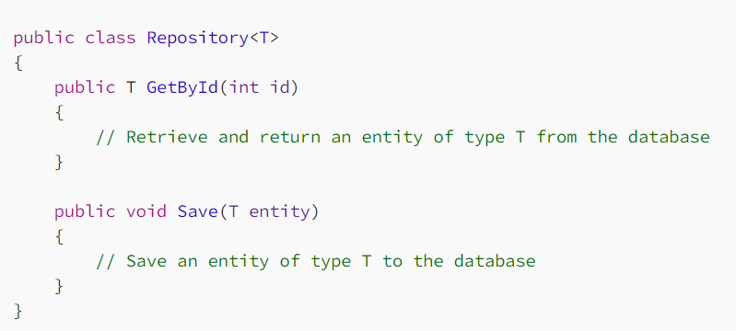
Database Access Generics
Generics can be a powerful tool when working with databases.
For instance, you can create a generic repository class that can perform common database operations on different entities without the need to duplicate code for each entity.

Slide 11
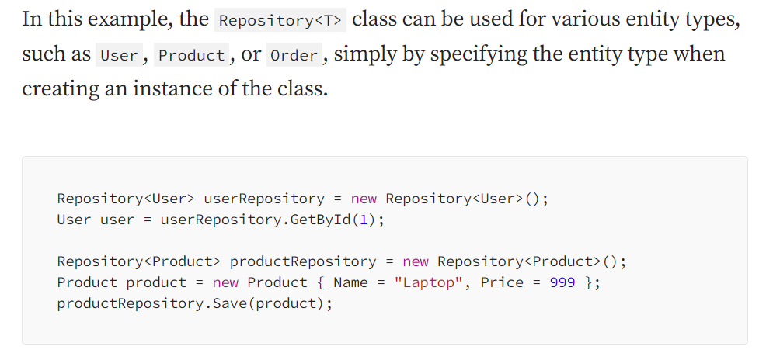
Database Access Generics

Slide 12
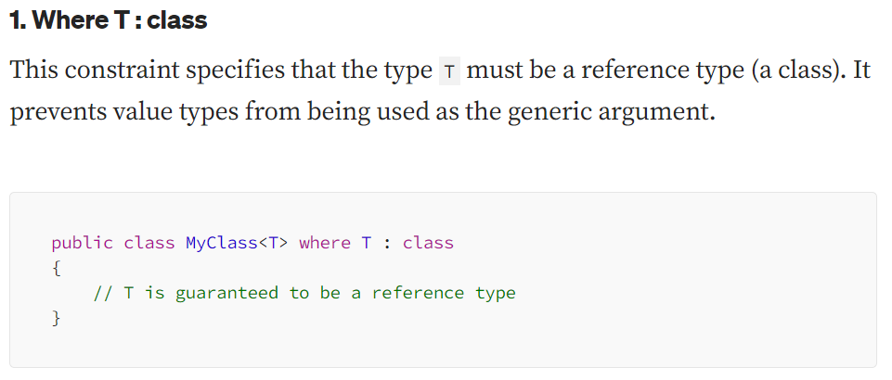
Constraints in Generics

Slide 13
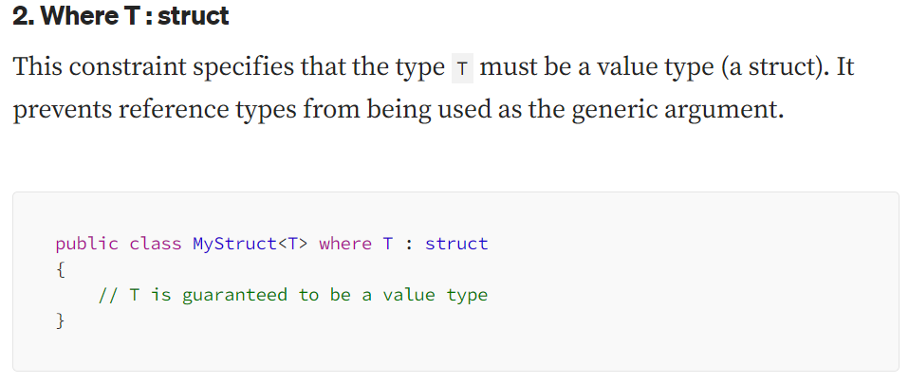
Constraints in Generics

Slide 14
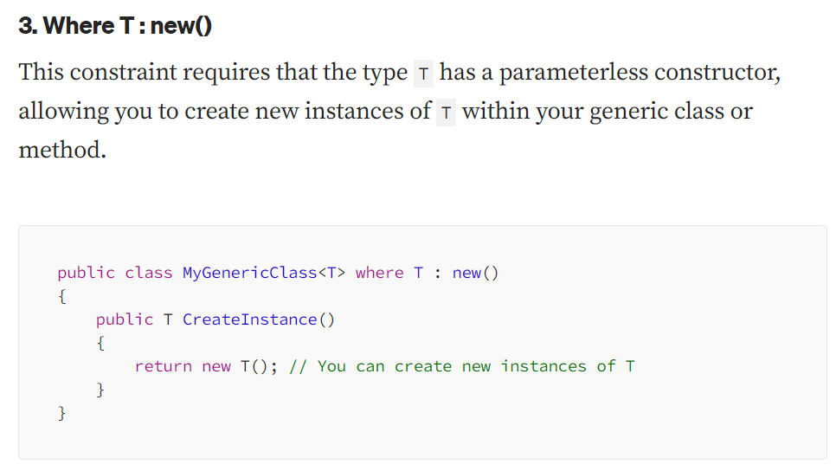
Constraints in Generics

Slide 15
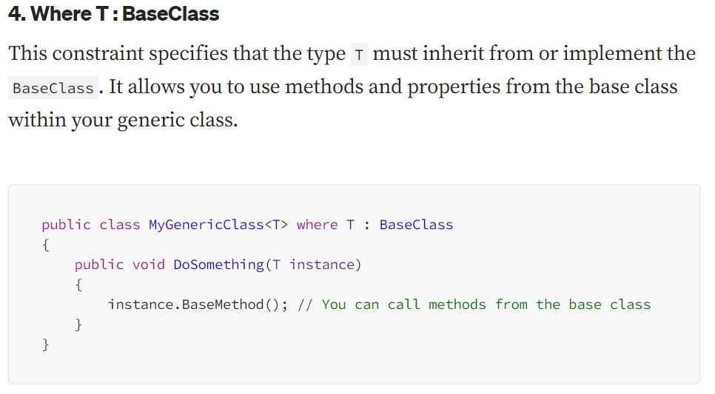
Constraints in Generics

Slide 16
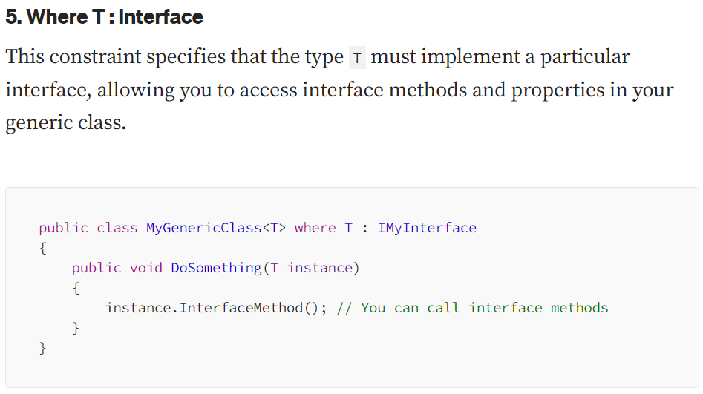
Constraints in Generics

Slide 17
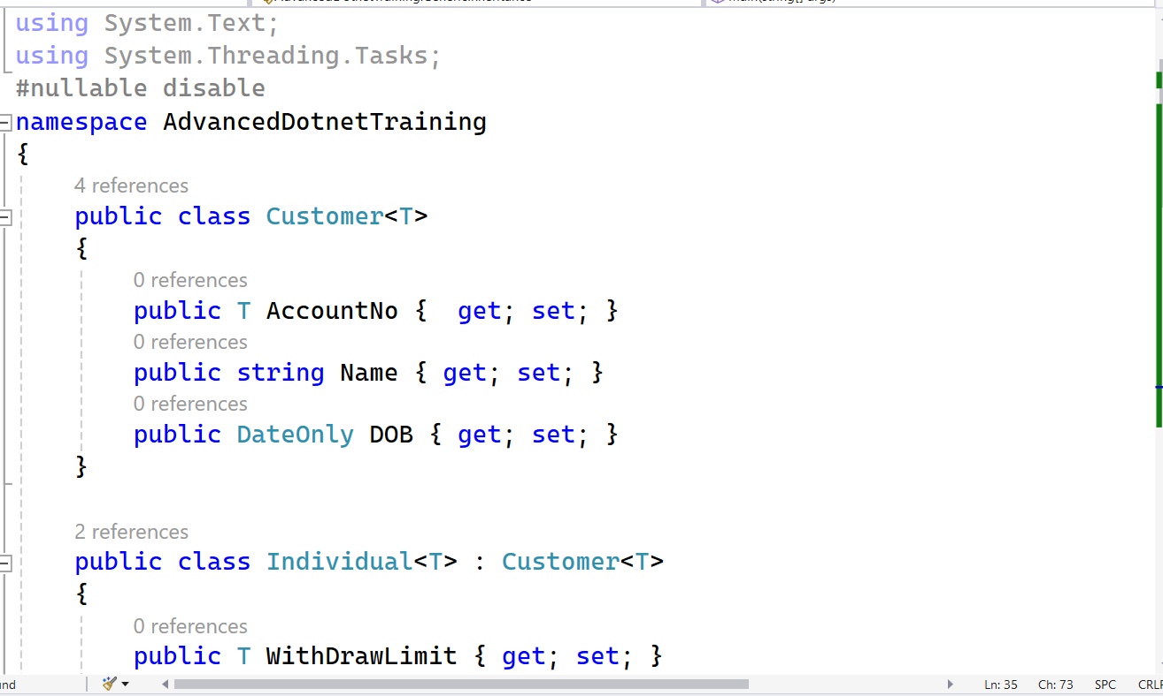
Generic Subclass

Slide 18
Covariance and contravariance in generics
Covariance
Enables you to use a more derived type than originally specified.
You can assign an instance of IEnumerable<Derived> to a variable of type IEnumerable<Base>.
Contravariance
Enables you to use a more generic (less derived) type than originally specified.
You can assign an instance of Action<Base> to a variable of type Action<Derived>.
Invariance
Means that you can use only the type originally specified. An invariant generic type parameter is neither covariant nor contravariant.

Slide 19
Delegates
A delegate is an object which refers to a method or you can say it is a reference type variable that can hold a reference to the methods.
If you click on a Button on a form (Windows Form application), the program will call a specific method.
In simple words, it is a type that represents references to methods with a particular parameter list and return type.
It then calls the method in a program for execution when it is needed.
We can say that the delegates in C# are the Type-Safe Function Pointer.

Slide 20
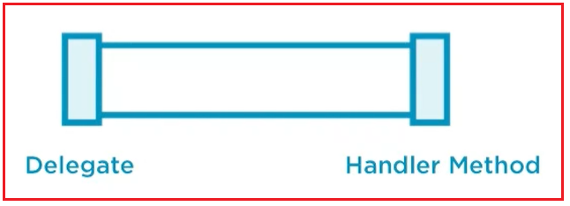
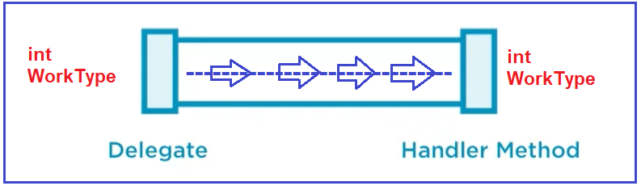
Delegates

Slide 21
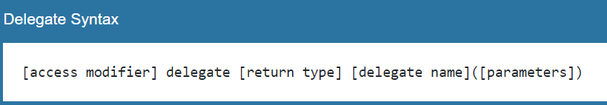
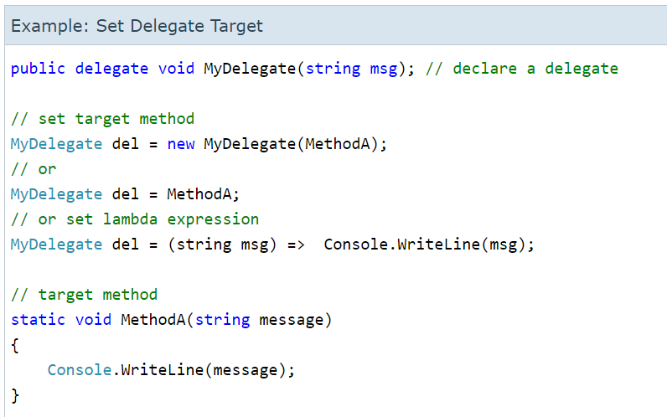
Delegates

Slide 22
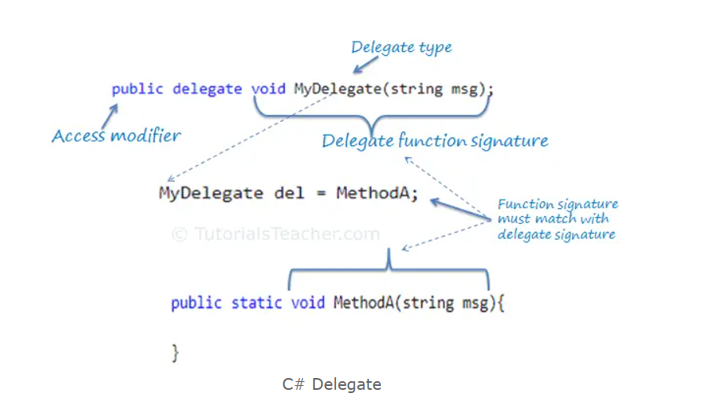
Delegates

Slide 23
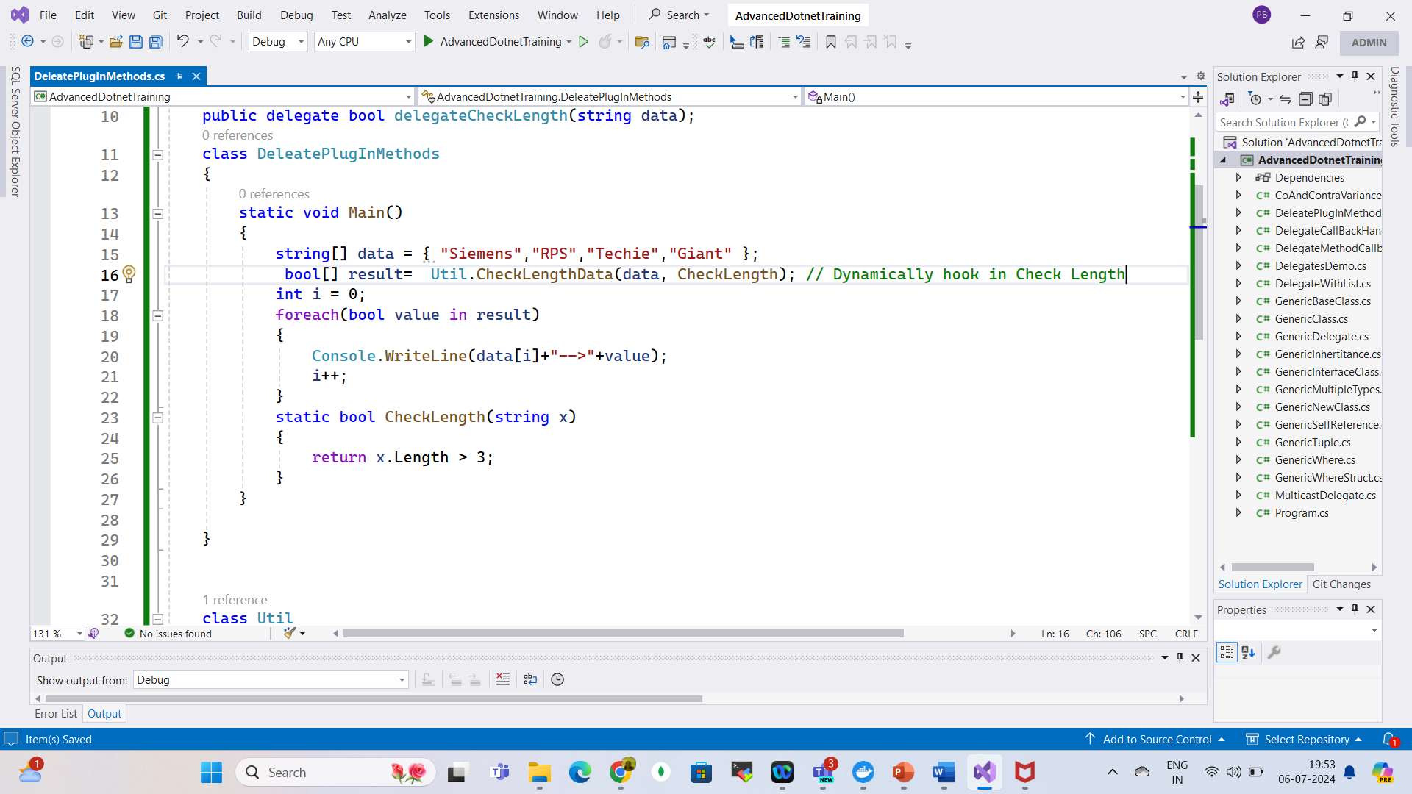
Delegates Plug-in Methods

Slide 24
Generic Delegates
Func Delegate in C#:
Func is a generic delegate present in the System namespace.
Func takes one or more input parameters and returns one out parameter, and the last parameter is considered as a return value.
It can include 0 to 16 input parameters of different types, but it must have one return type.

Slide 25
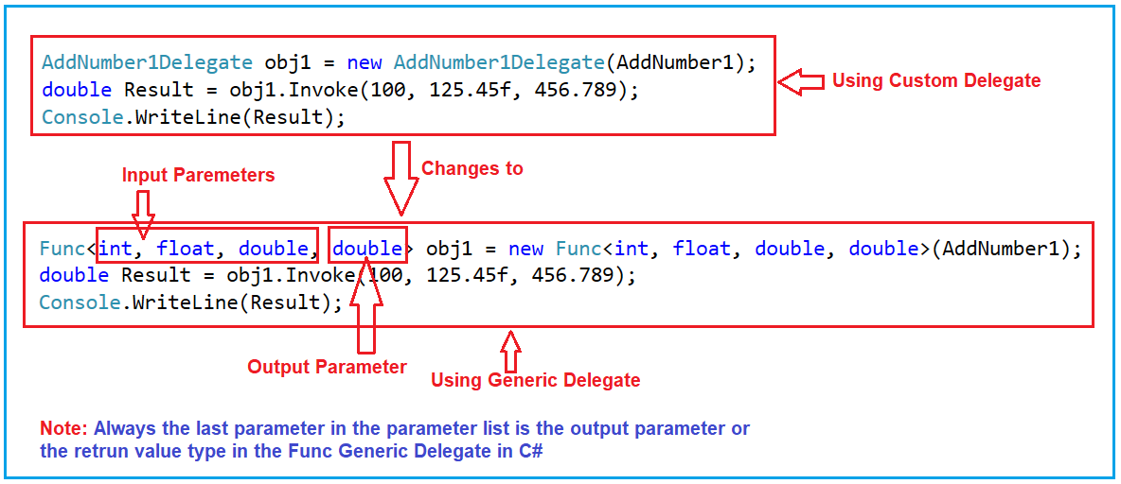
Generic Delegates

Slide 26
Generic Delegates
Action Delegate in C#
Action present in the System namespace.
It takes one or more than one input parameter and returns nothing.
It does not return any value.

Slide 27
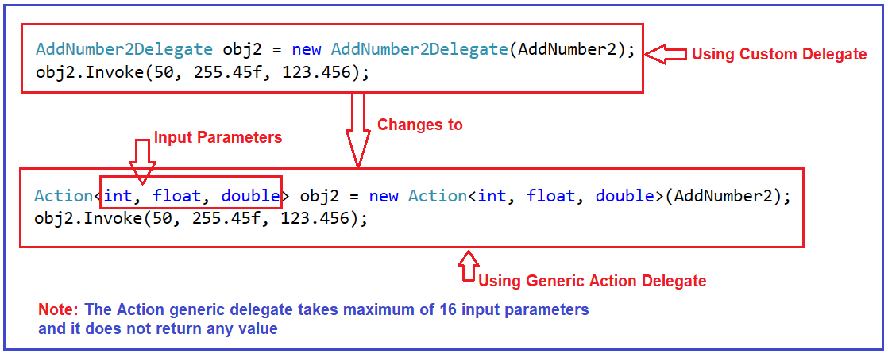
Generic Delegates

Slide 28
Generic Delegates
Predicate Delegate in C#
A predicate delegate is also an inbuilt generic delegate and is present in the System namespace.
predicate is used to verify certain criteria of the method and returns output as Boolean, either True or False.
The predicate can be used with the method, anonymous, and lambda expressions.

Slide 29
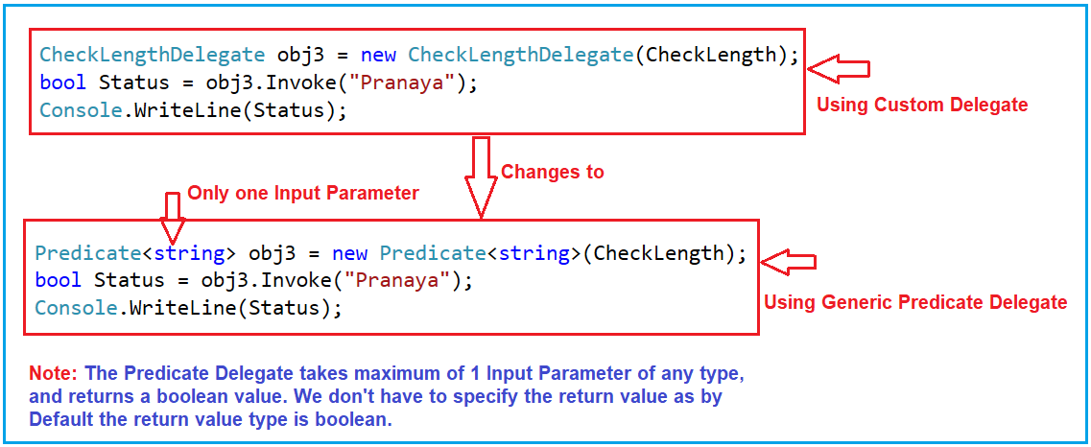
Generic Delegates

Slide 30
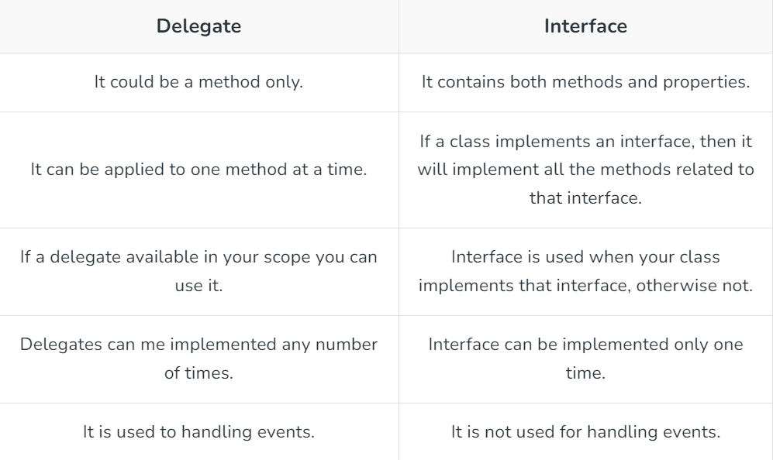
Delegate vs Interface

Slide 31
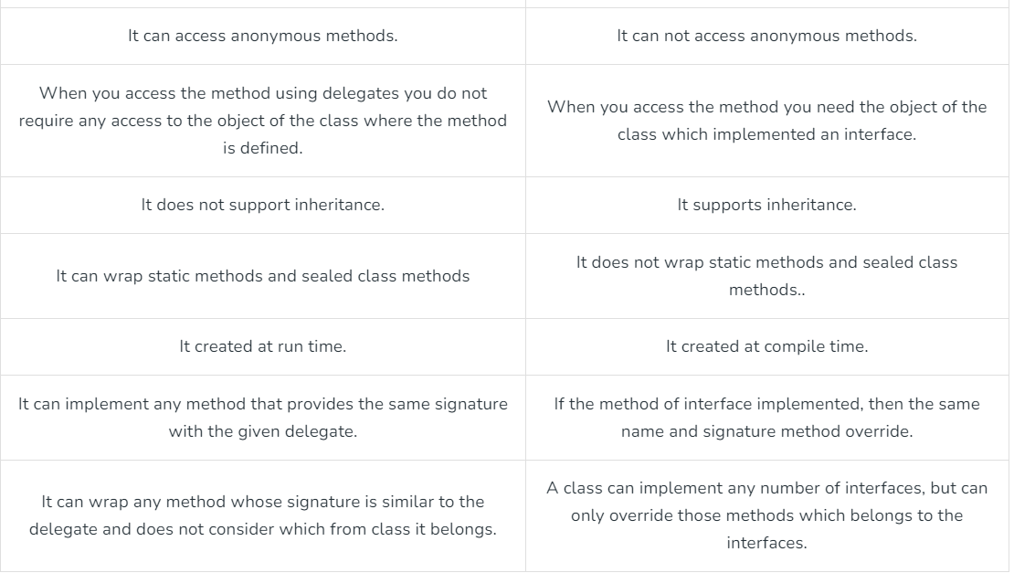
Delegate vs Interface

Slide 32
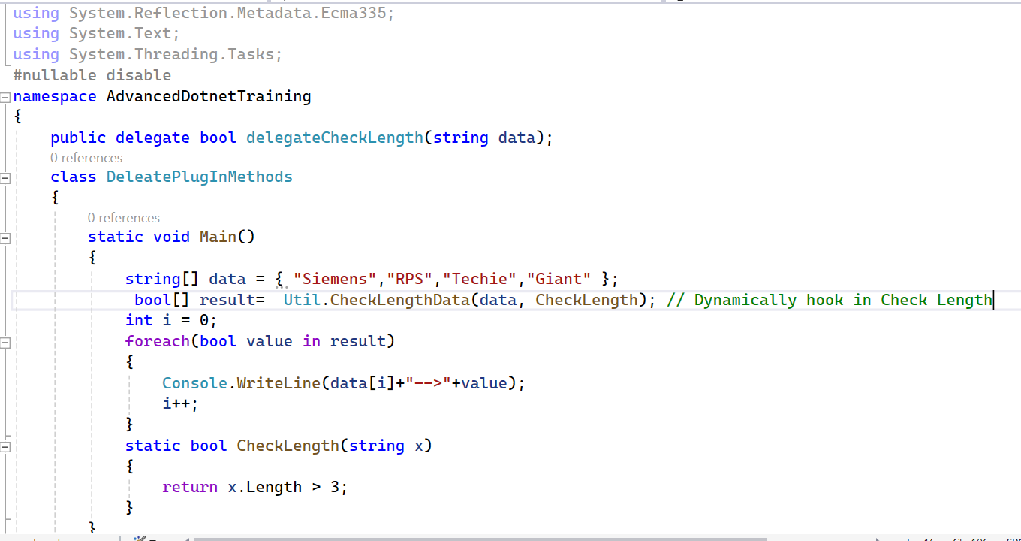

Delegate Compatibility
Check Compatibility

Slide 33
Events
Events enable a class or object to notify other classes or objects when something of action occurs.
The class that sends (or raises) the event is called the publisher and the classes that receive (or handle) the event are called subscribers.
There can be multiple subscribers to a single event.
Typically, a publisher raises an event when some action occurred.
The subscribers, who are interested in getting a notification when an action occurred, should register with an event and handle it.

Slide 34
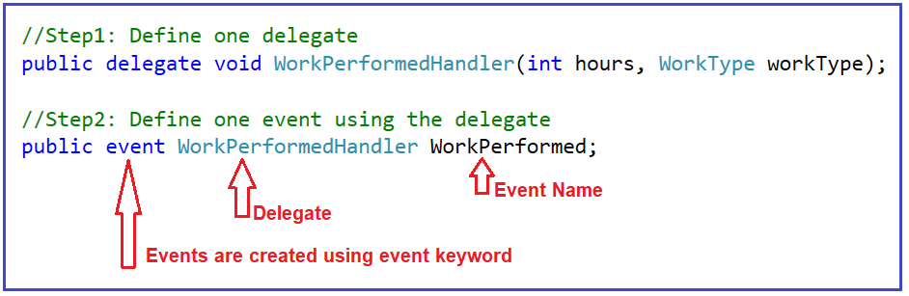
Defining an Event in C#

Slide 35
Events
We created the Work Performed event using the Work Performed Handler delegate.
This is important because an event on its own does not really do anything.
We must have a pipeline or delegate which routes the data from Point A to Point B, that is from Event Raiser to Event Handler or Event Listener.
It is going to be our delegate.
So, events are really wrappers around the delegate.
This is the entire process of defining an event.

Slide 36
Events
An event is a notification sent by an object to signal the occurrence of an action.
The class who raises events is called Publisher, and the class who receives the notification is called Subscriber.
There can be multiple subscribers of a single event.
Typically, a publisher raises an event when some action occurred.
The subscribers get notification when an action occurred.
Subscribers should register with an event and handle it.

Slide 37
Events
If delegates can use their own, then why events?
It is the standard way to provide notification that is the best way to implement publisher and subscriber pattern.
In this case, the listeners can go and attach to the Work Performed event.
But behind the scenes, they are adding themselves to the Invocation List through the Work Performed Handler delegate in the event definition.

Slide 38
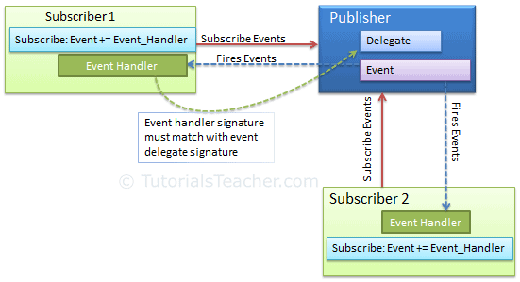
Events

Slide 39
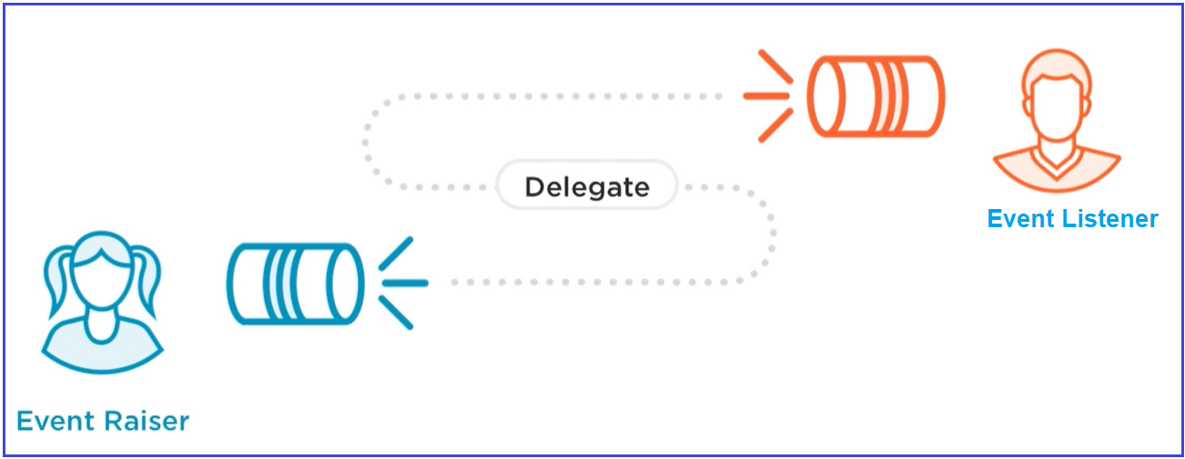
Events

Slide 40
Event Handler
Events and event handlers are generally used in case of a Publisher-Subscriber design pattern.
When ever event has occurred in a particular class, it needs to notify other classes about the event.
The Publisher class has an event which gets invoked on some condition, the subscribers are notified based on their subscription.
One Key benefit of this is the publisher does not need to know anything about who gets notified.

Slide 41
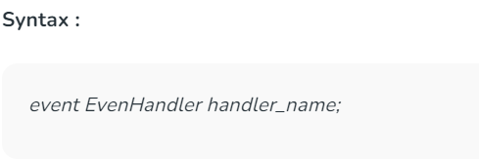
Event Handler
Event Handler is a delegate.
To subscribe to this event a class must have a method with void return type and two input parameters of types :
Object – The source or publisher who invoked the event.
Event Args – An object class which contains the event information.

Slide 42
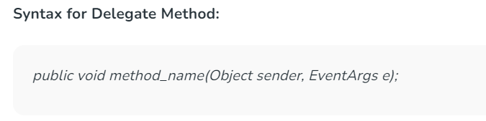
Event Handler
The Subscriber must have a method of same signature as described above to receive the event notification from the publisher.

Slide 43
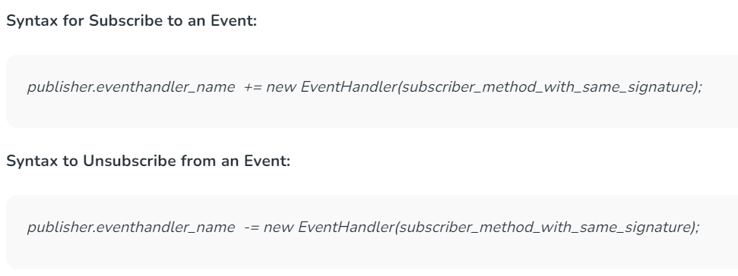
Event Handler

Slide 44
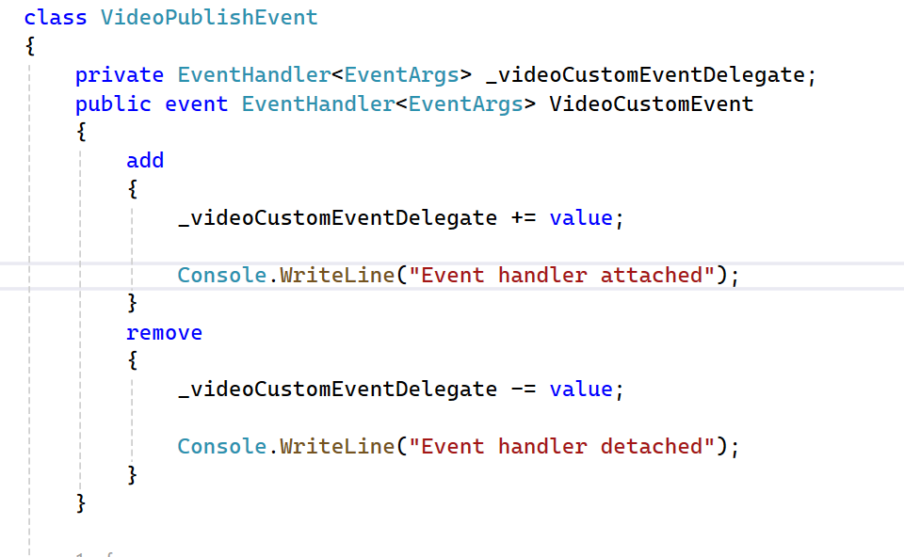
Event Accessors

Slide 45
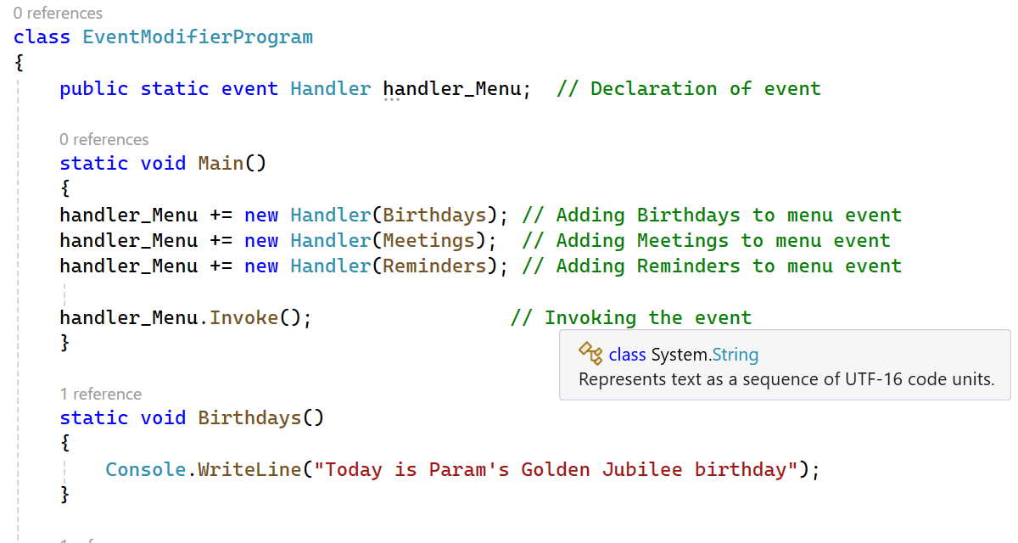
Event Modifiers

Slide 46
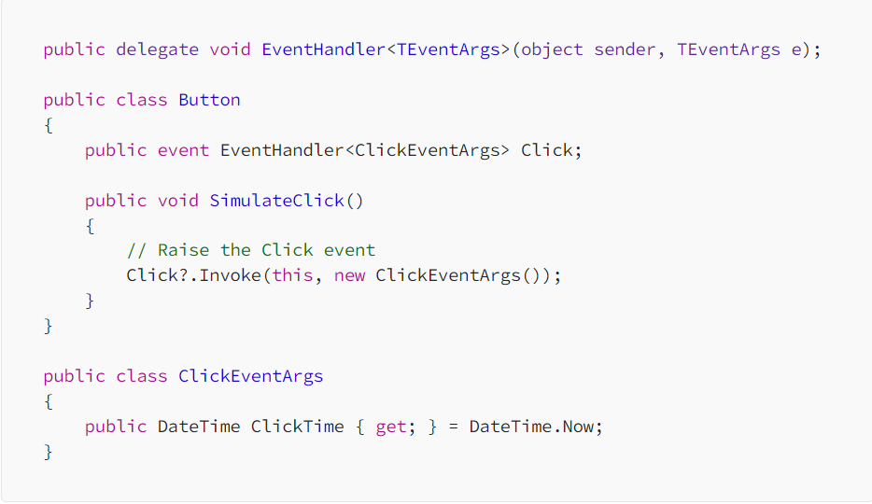
Delegates and Events Generics

Slide 47
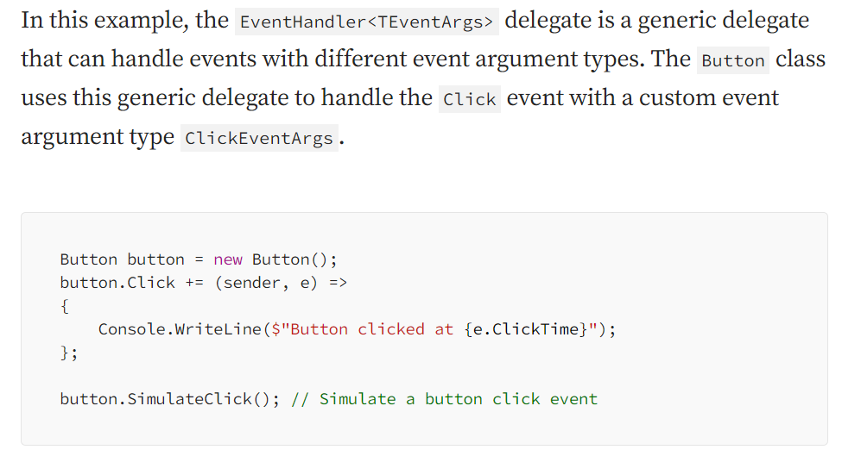
Delegates and Events Generics

Slide 48
Lambda Expressions
Lambda expressions in C# are used like anonymous functions.
Lambda expressions need not to specify the type of the value that you input thus making it more flexible to use.
The ‘=>’ is the lambda operator which is used in all lambda expressions.
The Lambda expression is divided into two parts, the left side is the input, and the right is the expression.

Slide 49
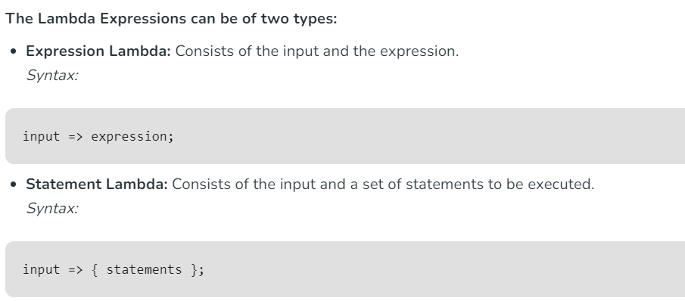
Lambda Expressions

Slide 50
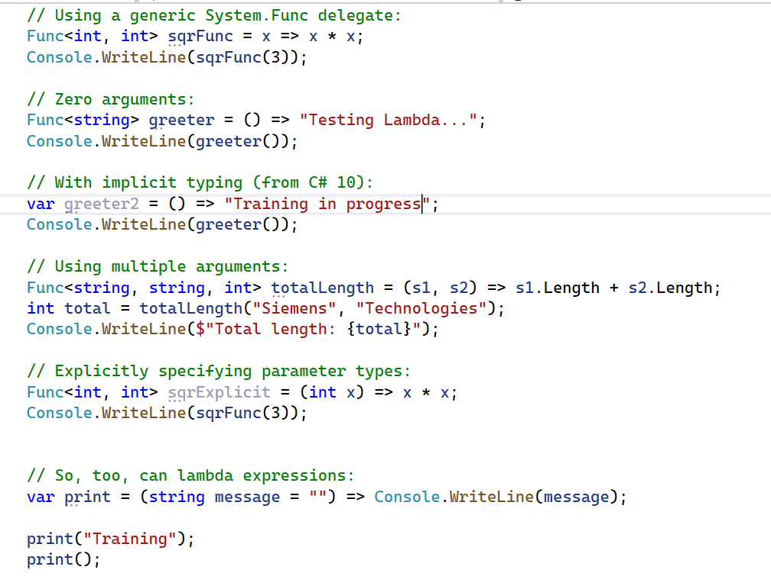
Explicitly Specifying Lambda Parameter and Return Types

Slide 51
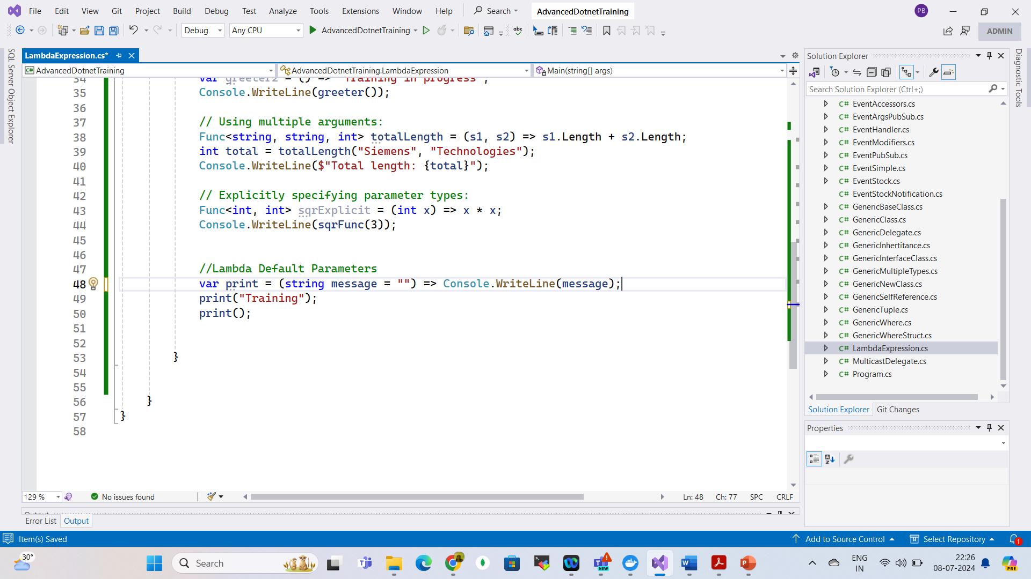
Lambda Expressions - Default Parameters

Slide 52
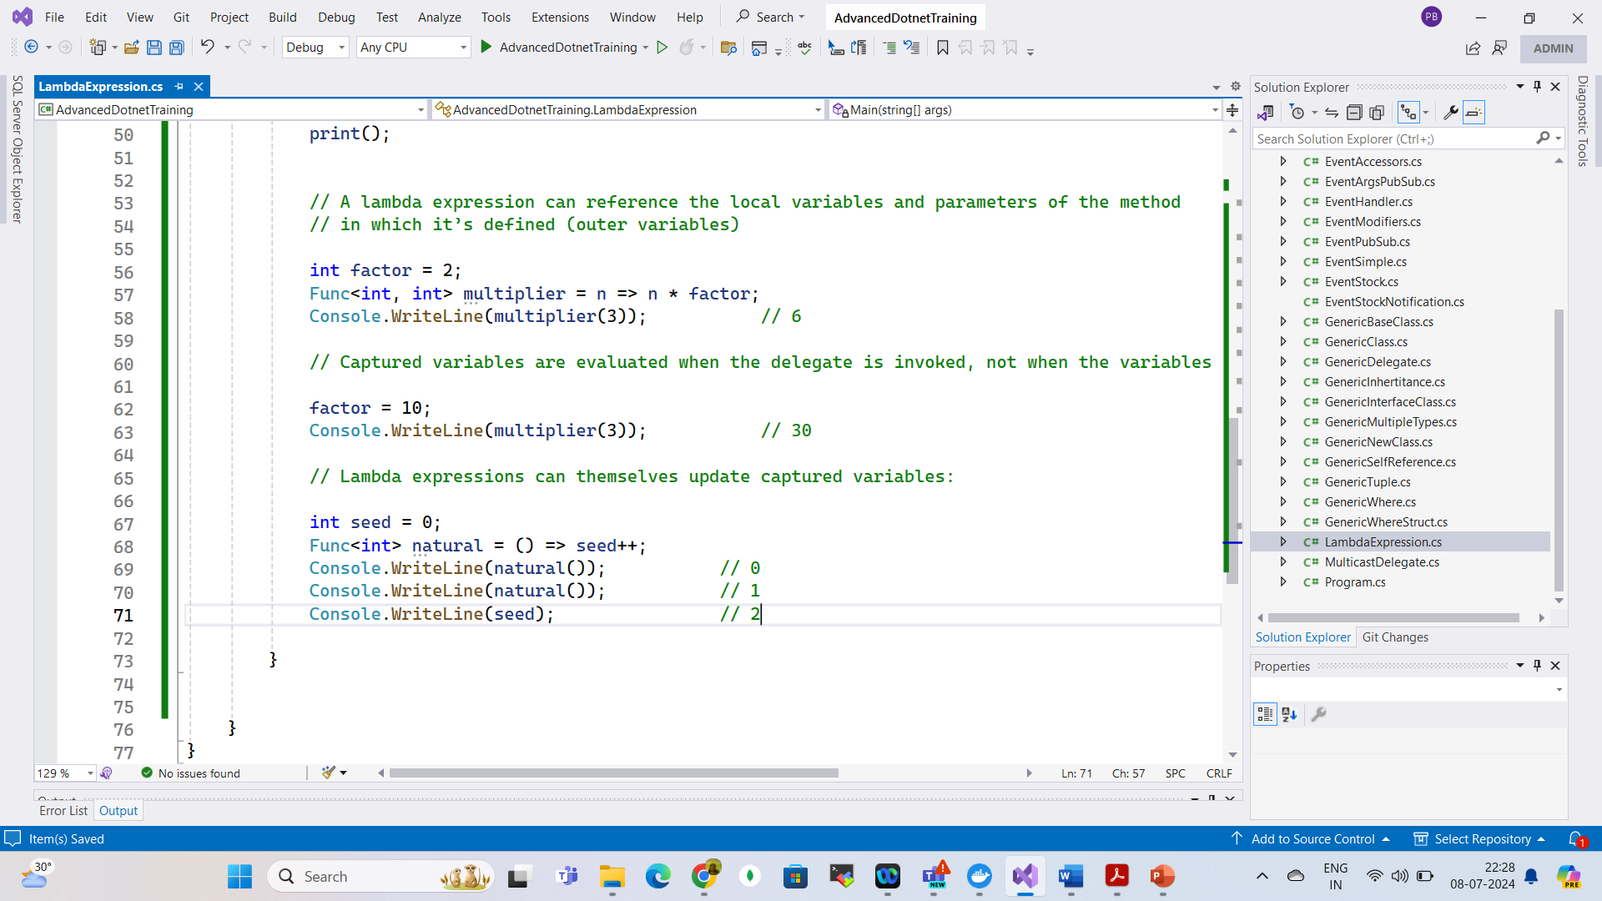
Capturing Outer Variables

Slide 53
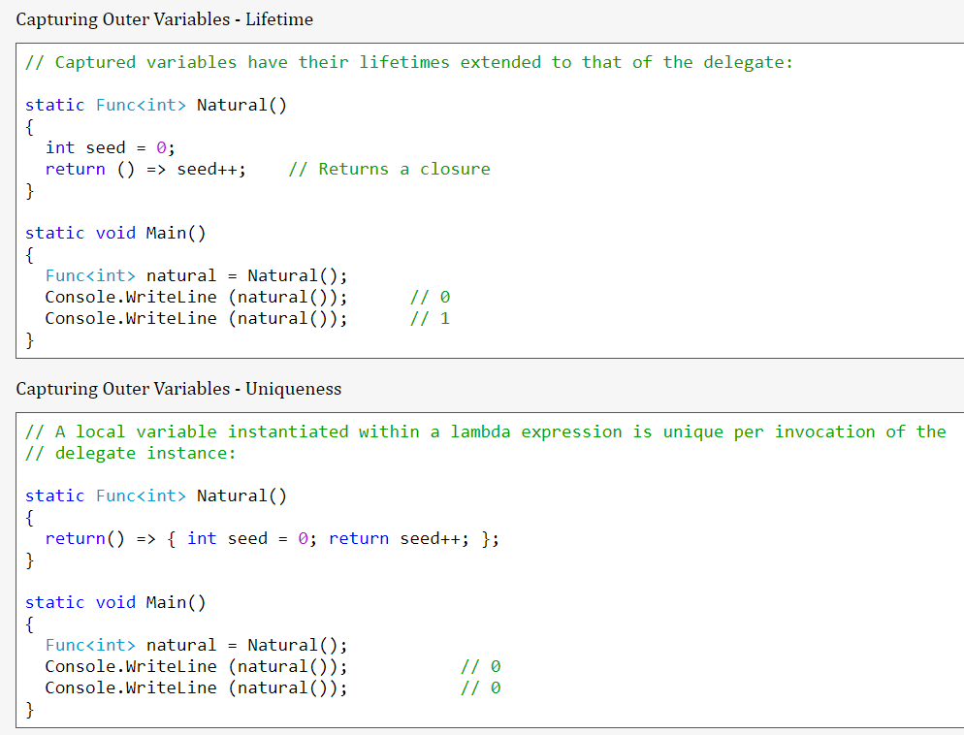
Capturing Outer Variables

Slide 54
Capturing Outer Variables

Slide 55
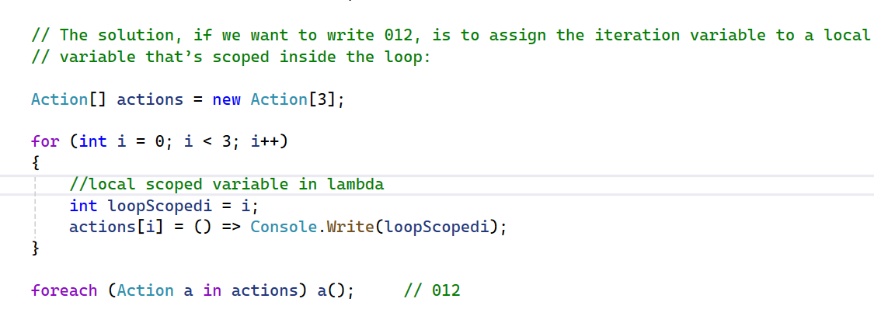
Lambda Expressions Versus Local Methods

Slide 56
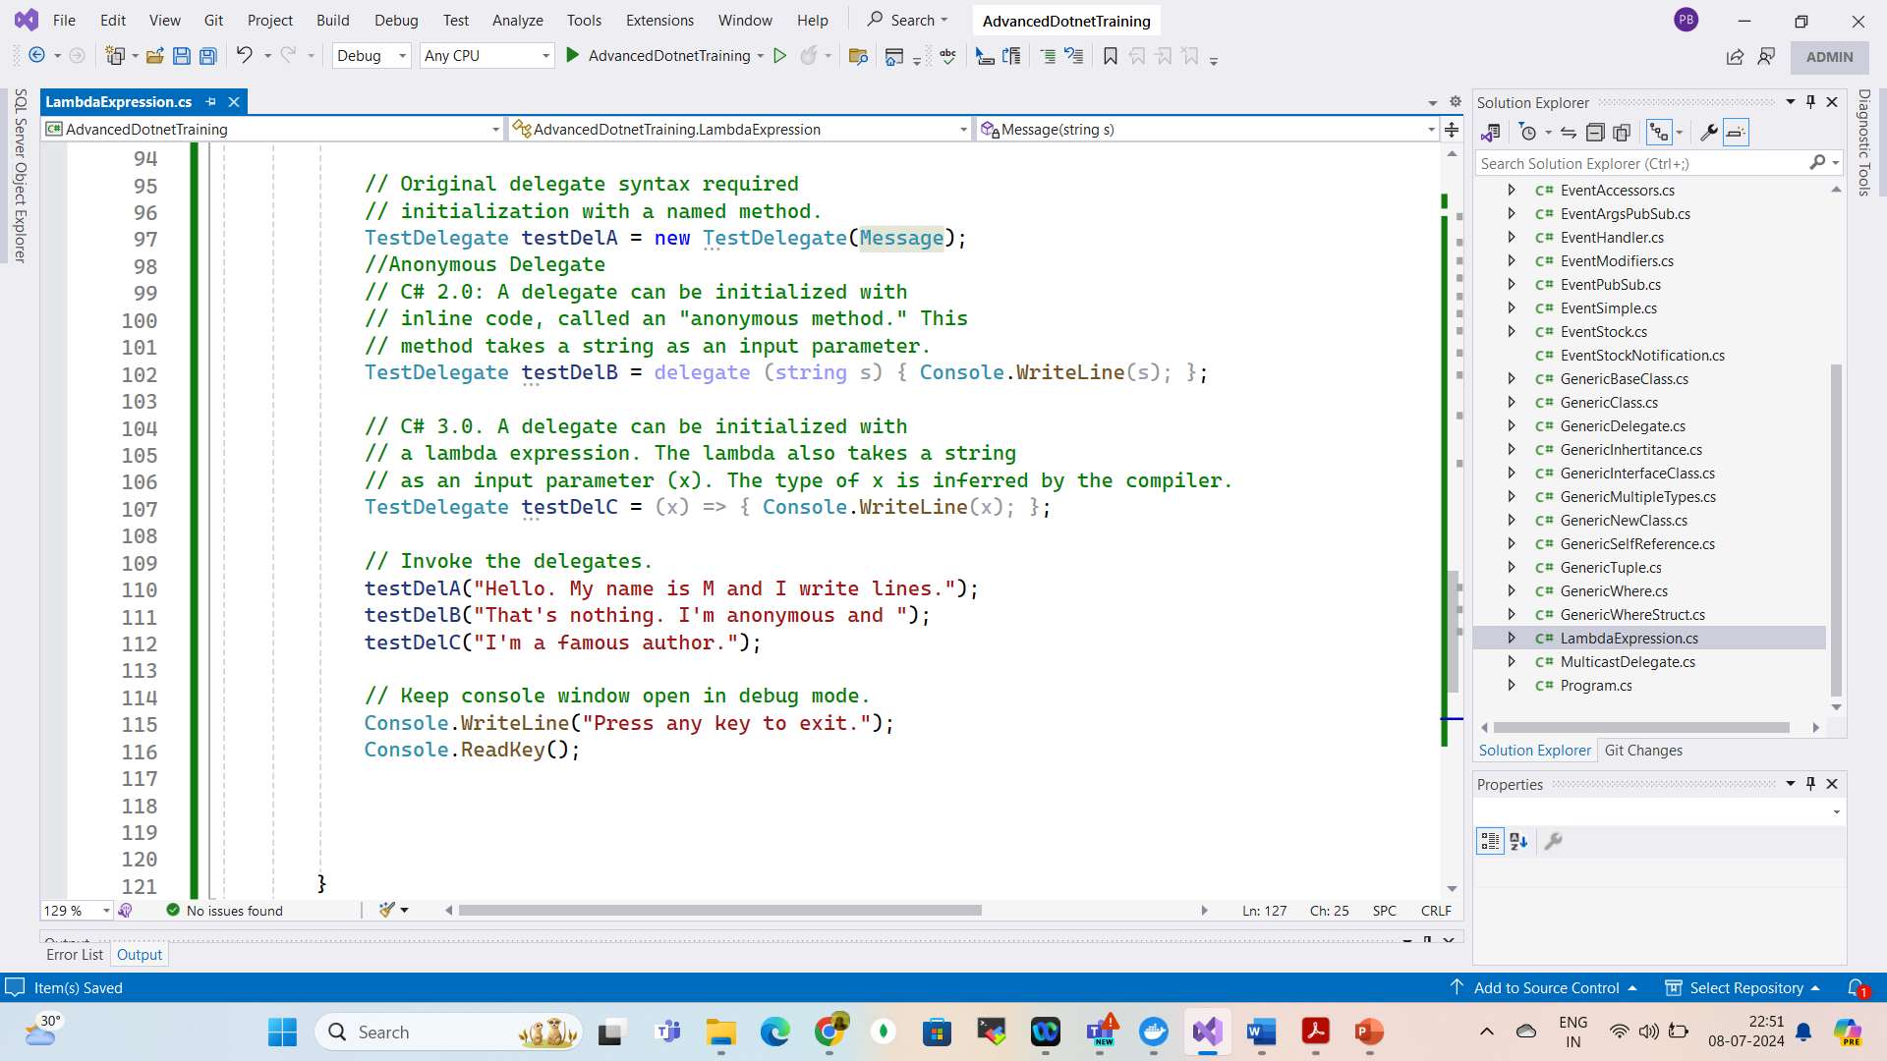
Anonymous Methods

Slide 57
Extension Method
Extension methods make it possible to extend existing types and constructed types with additional methods.
Extension methods are static methods that can be invoked using instance method syntax.
We declare extension methods by using this keyword on the first parameter of the method.
We can declare extension methods only in static class and the extension method itself should be static.

Slide 58
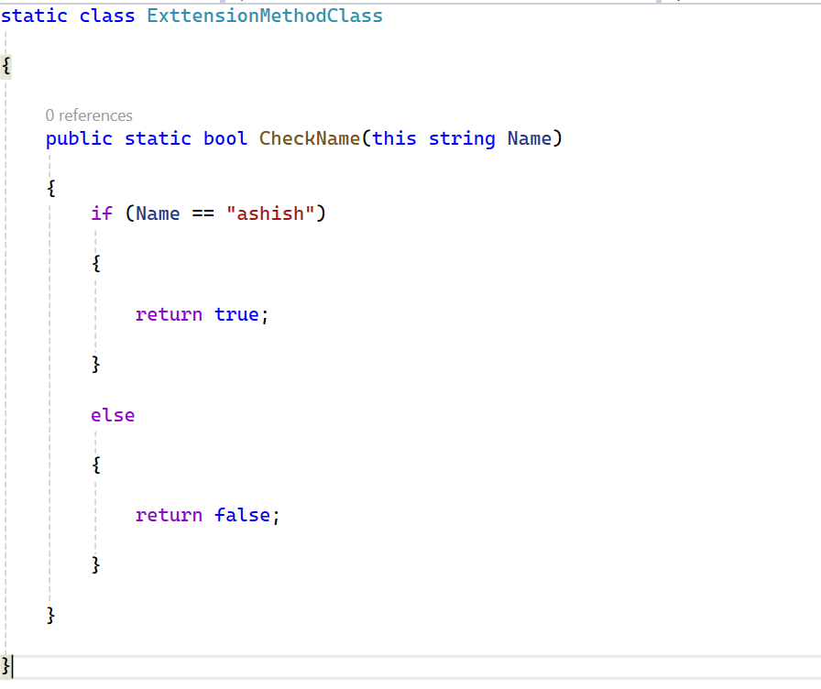
Extension Method

Slide 59
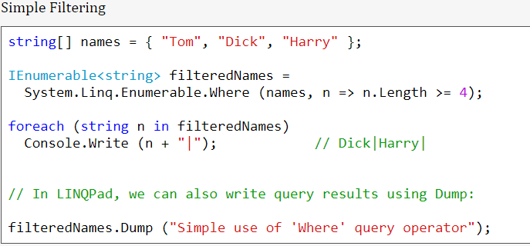
LINQ Queries

Slide 60
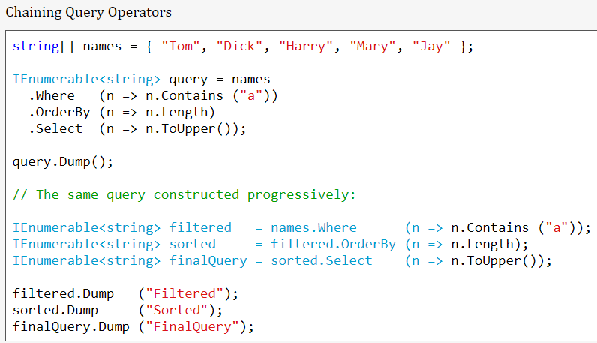
Fluent Queries

Slide 61
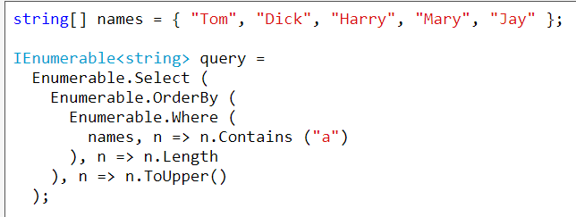
Extension Methods

Slide 62
Extension Methods

Slide 63
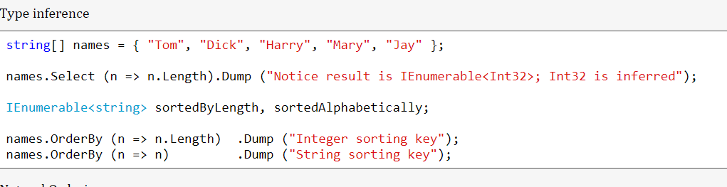
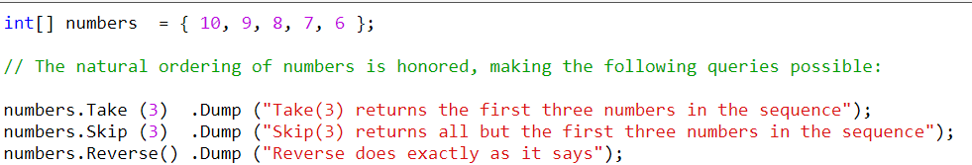
Type Inference & Natural Ordering
Natural Ordering

Slide 64
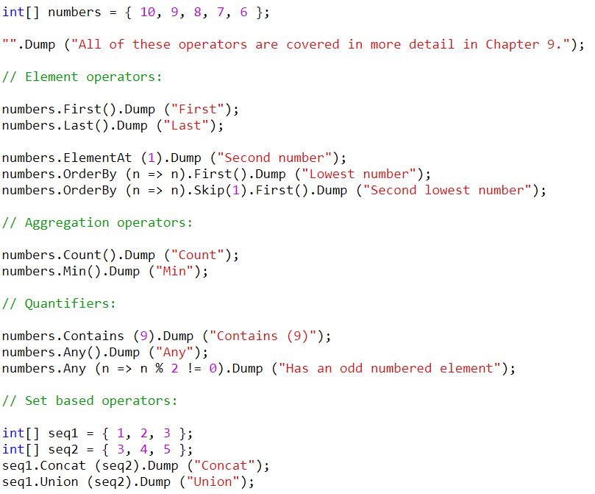
Other Operators

Slide 65
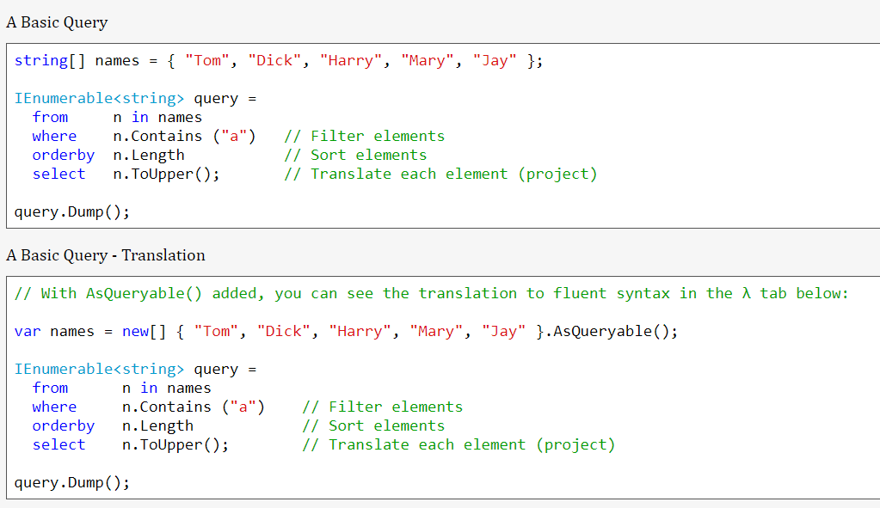
Query Operations

Slide 66
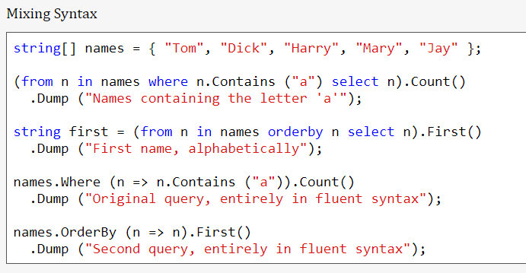
Query Operations

Slide 67

Deferred Execution

Slide 68


Deferred Execution

Slide 69
Deferred Execution

Slide 70

Sub Queries

Slide 71

Sub Queries

Slide 72

Avoiding Sub Queries

Slide 73

Composite Strategies

Slide 74


Composite Strategies

Slide 75

Composite Strategies

Slide 76

Projection Queries

Slide 77

Projection Queries

Slide 78

Projection Queries

Slide 79

Interpreted Queries

Slide 80

Interpreted Queries

Slide 81

Interpreted Queries

Slide 82
Threading
Threads are the backbone of any software application.
In simple terms, a thread is a single sequence of instructions that a process can execute.
In C#, the System.Threading namespace offers classes that allow you to manipulate threads.
When a C# program starts, it’s a single threaded process by default.
This “main” thread is responsible for executing your code line by line, creating what is known as a single threaded application.
Threads make it possible to execute several program pieces concurrently, enhancing the program’s efficiency.
This brings us to the concept of multithreading.

Slide 83

Thread Lifecycle

Slide 84

Thread Lifecycle

Slide 85
Types of Threads
Foreground Threads: These threads are created using the Thread class in C#.
They are the main threads of an application.
They prevent the application from terminating until all foreground threads have completed their tasks.
A foreground thread can be created by calling the Thread.Start() method.

Slide 86
Types of Threads
Background Threads: These threads are also created using the Thread class in C#, but they are the secondary threads of an application.
They do not prevent the application from terminating, even if they are still running.
A background thread can be created by calling the Thread.Start() method and then setting the IsBackground property of the thread to true before starting it.

Slide 87
Types of Threads
When an application starts, it automatically creates a foreground thread, which is the main thread of the application.
All the threads are background thread by default.
We can change the type of a thread by setting the IsBackground property of the thread.

Slide 88
Types of Threads
Foreground threads are useful when we need to perform a task that is critical to the operation of the application and must be completed before the application can terminate.
For example, a foreground thread might be used to update the user interface or to perform important calculations.

Slide 89
Types of Threads
Background threads are useful when you need to perform a task that is not critical to the operation of the application and can be terminated if the application needs to shut down.
For example, a background thread might be used to download a large file or to perform periodic updates to a database.

Slide 90

Thread Properties

Slide 91

How to create Thread

Slide 92

Thread Lifecycle

Slide 93
Multithreading
In c#, multithreading means executing multiple threads simultaneously to perform multiple tasks at a time.
The perfect example of multithreading is the operating system.
For example, in the windows operating system, we can open multiple applications like excel, word, notepad, browser, etc., to perform multiple tasks simultaneously.
In an operating system, each application process will be taken care by separate threads.

Slide 94

Multi Threading

Slide 95
Joining Threads in C#
In C#, we can create and run multiple threads simultaneously to perform different tasks concurrently.
Sometimes, it is necessary to wait for one thread to complete before starting another thread or wait for all threads to complete before proceeding further.
To achieve this, we can use the following methods to join threads in C#:
Thread.Join(): The Join method of the Thread class waits for the thread to complete its execution before continuing with the execution of the calling thread.
This method blocks the calling thread until the target thread has completed its execution.

Slide 96

Joining Threads in C#

Slide 97

Sleep
In c#, the sleep method is useful to suspend or pause the current thread execution for a specified time.

Slide 98
Synchronization
Synchronization is the act of coordinating concurrent actions for a predictable outcome.
Synchronization is particularly important when multiple threads access the same data.

Slide 99
The synchronization constructs
Exclusive locking
Exclusive locking constructs allow just one thread to perform some activity or execute a section of code at a time.
Their primary purpose is to let threads access shared writing state without interfering with one another.
The exclusive locking constructs are lock, Mutex, and SpinLock.

Slide 100
The synchronization constructs
Nonexclusive locking
Nonexclusive locking lets us limit concurrency.
The nonexclusive locking constructs are Semaphore(Slim) and ReaderWriterLock(Slim)

Slide 101
The synchronization constructs
Signaling
These allow a thread to block until receiving one or more notifications from other thread(s).
The signaling constructs include Manual Reset Event(Slim),AutoResetEvent, CountdownEvent, and Barrier.
The former three are referred to as event wait handles.

Slide 102
Thread Safety and .NET Types
We can use locking to convert thread-unsafe code into thread-safe code.
A good application of this is .NET: nearly all its nonprimitive types are not thread-safe (for anything more than read-only access) when instantiated.
We can use them in multithreaded code if all access to any given object is protected via a lock.

Slide 103

Blocking (Exclusive Lock in Thread)
The lock statement is used to take the mutual-exclusion lock for a specified object.
It executes a specified block and then releases the lock.
The time during which the lock is active, the thread that holds the lock can again take and release the lock.
Note that any other thread cannot access the lock and it waits unless the lock is released.

Slide 104

Blocking (Lock in Thread)

Slide 105

Pass Parameter to Thread

Slide 106

Thread Exception Handling

Slide 107
Thread Priority
In a Multithreading environment, each thread has their own priority.
A thread’s priority shows how frequently a thread gains the access to CPU resources.
Whenever we create a thread in C#, it always has some priority assigned to it.

Slide 108
Thread Priority
A programmer can explicitly assign priority to a thread.
The by default priority of a thread is Normal.
Operating system does not assign the priority of threads.
If a thread has reached a final state, such as Aborted, then this will give ThreadStateException.
If the value specified for a set operation is not a valid ThreadPriority value, then this will give ArgumentException
It is not guaranteed that the thread whose priority is high will executes first and the thread whose priority is low will executes after.
Due to context switching the highest priority thread may execute after lowest priority thread.
When you are assigning a priority to a thread you need to be careful, if you are not doing carefully you may get thread starvation.
The thread priority will always depend upon the process priority or parent container, so by setting the thread priority to highest will not correspond to real-time execution.

Slide 109

Thread Priority

Slide 110
Local Versus Shared State
The CLR assigns each thread its own memory stack.
So that local variables are kept separate.
We define a method with a local variable.
Then call the method simultaneously on the main thread and a newly created thread:

Slide 111

Local Versus Shared State

Slide 112

Local Versus Shared State

Slide 113
Signaling with Event Wait Handles
The simplest kind of signaling constructs are called event wait handles.
Event wait handles come in three flavors: AutoResetEvent, Manual ResetEvent(Slim), and CountdownEvent.
The former two are based on the common EventWaitHandle class from which they derive all their functionality.

Slide 114

Signaling with Event Wait Handles

Slide 115

Signaling with Event Wait Handles

Slide 116
Barrier
The Barrier class implements a thread execution barrier, allowing many threads to rendezvous at a point in time.
The class is very fast and efficient, and is built upon Wait, Pulse, and spinlocks.
To use this class:
1. Instantiate it, specifying how many threads should partake in the rendezvous.
2. Have each thread call SignalAndWait when it wants to rendezvous.
Instantiating Barrier with a value of 3 causes SignalAndWait to block until that method has been called three times.
It then starts over: calling SignalAndWait again blocks until called another three times.
This keeps each thread “in step” with every other thread.

Slide 117
Barrier

Slide 118

Barrier

Slide 119

Parallel vs Asynchronous
Parallel execution means that you have multiple threads doing different job and not knowing about each other.
Asynchronous execution refers to having single thread switching between different jobs.

Slide 120
Thread Pool
Whenever we start a thread, a few hundred microseconds are spent organizing such things as a fresh local variable stack.
The thread pool cuts this overhead by having a pool of pre-created recyclable threads.
Thread pooling is essential for efficient parallel programming and fine-grained concurrency;
It allows short operations to run without being overwhelmed with the overhead of thread startup.

Slide 121
Thread Pool
We cannot set the Name of a pooled thread, making debugging more difficult.
Pooled threads are always background threads.

Slide 122
Task
.NET framework provides Threading.Tasks class to let us create tasks and run them asynchronously.
A task is an object that represents some work that should be done.
The task can tell you if the work is completed and if the operation returns a result, the task gives you the result.

Slide 123

Task

Slide 124
Differences Between Task And Thread
The Thread class is used for creating and manipulating a thread in Windows.
A Task represents some asynchronous operation and is part of the Task Parallel Library, a set of APIs for running tasks asynchronously and in parallel.
The task can return a result.
There is no direct mechanism to return the result from a thread.
Task supports cancellation using cancellation tokens. But Thread doesn't.
A task can have multiple processes happening at the same time.
Threads can only have one task running at a time.

Slide 125
Differences Between Task And Thread
We can easily implement Asynchronous using ’async’ and ‘await’ keywords.
A new Thread() is not dealing with Thread pool thread, whereas Task does use thread pool thread.
A Task is a higher level concept than Thread.

Slide 126

Entering Thread Pool
The easiest way to explicitly run something on a pooled thread is to use Task.Run
// Task is in System.Threading.Tasks
Task.Run (() => Console.WriteLine ("Hello from the thread pool"));

Slide 127
Task
The easiest way to start a Task backed by a thread is with the static method Task.Run.
Simply pass in an Action delegate:
Task.Run (() => Console.WriteLine (“Rocking…"));

Slide 128
Task
Calling Task.Run in this manner is same as starting a thread as follows
new Thread (() => Console.WriteLine (“Rock")).Start();
Task.Run returns a Task object that we can use to monitor its progress, rather like a Thread object.

Slide 129

Wait

Slide 130

Returning values
Task has a generic subclass called Task<TResult>, which allows a task to emit a return value.
We can obtain a Task<TResult> by calling Task.Run with a Func <TResult> delegate instead of an Action:
Task<int> task = Task.Run (() => { Console.WriteLine (“Rock"); return 3; }
int result = task.Result; // Blocks if not already finished
Console.WriteLine (result); //

Slide 131

Exceptions

Slide 132

Creating a continuation for a single antecedent

Slide 133

Scheduling Different Continuation Tasks

Slide 134

Parallel Programming
Nowadays, multicore processors (2 cores, 4 cores, 8 cores …) become very popular.
Even they can be found in most devices.

Slide 135

Parallel Programming

Slide 136

Parallel Programming

Slide 137

Parallel Programming

Slide 138

Parallel Programming

Slide 139

Parallel Programming

Slide 140

Parallel Programming

Slide 141


PLINQ

Slide 142

PLINQ

Slide 143

PLINQ AS Ordered

Slide 144

PLINQ AS Ordered

Slide 145

PLINQ AS Ordered

Slide 146

Parallel Invoke

Slide 147

Parallel Cancellation

Slide 148

Parallel Cancellation

Slide 149

Parallel Cancellation

Slide 150
Common Pitfalls and Best Practices
Overuse of Generics
Using generics for every scenario may lead to code that is overly complex and hard to understand.
It’s essential to strike a balance and use generics where they genuinely add value.
Avoid Tight Coupling
Avoid creating overly complex generic classes that are tightly coupled with various types.
Tight coupling can make your code less maintainable and harder to test.

Slide 151
Common Pitfalls and Best Practices
Provide Clear Documentation
When creating generic classes or methods, document their usage and constraints clearly.
Good documentation helps other developers understand how to use your generics effectively.
Test with Multiple Types
When designing generic classes or methods, thoroughly test them with various data types to ensure they work correctly and safely under different scenarios.

Slide 152
Common Pitfalls and Best Practices
Consider Code Duplication
Generics can be an excellent way to reduce code duplication,
But be cautious not to overcomplicate your codebase. Sometimes, it might be better to have separate non-generic implementations for specific cases.

Slide 153
Questions

Slide 154
Module Summary
Microservices using docker and Kubernets.
Message, Channel and Adapter
Understood the different Component Integration
Understood the Event-Driven Architecture

